Slide 1
Module 3 (Part I)
OOP Concepts

Slide 2
Object Oriented is a popular design approach for analyzing and designing an application
Most of the languages like C++, Java, .net are use object oriented design concept
Object-oriented concepts are used in the design methods such as classes, objects, polymorphism, encapsulation, inheritance, coupling and cohesion, information hiding, constructor, destructor etc..

Slide 3
The main advantage of object oriented design is that improving the software development and maintainability
Another advantage is that faster and low cost development, and creates a high quality software
The disadvantage of the object-oriented design is that larger program size and it is not suitable for all types of program

Slide 4
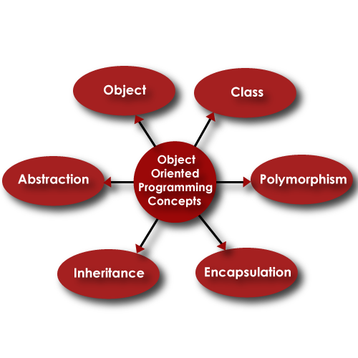
The different terms related to object design are:

Slide 5
Class :
A class is a collection of method and variables
It is a blueprint that defines the data and behavior of a type
Let’s take HumanBeing as a class
A class is a blueprint for any functional entity which defines its properties and its functions
Like HumanBeing, having body parts, performing various actions

Slide 6
Inheritance :
Inheritance is a feature of object-oriented programming that allows code reusability when a class includes property of another class
Considering HumanBeing a class, which has properties like hands, legs, eyes, mouth, etc, and functions like walk, talk, eat, see, etc.
Man and Woman are also classes, but most of the properties and functions are included in HumanBeing
Hence, they can inherit everything from class HumanBeing using the concept of Inheritance

Slide 7
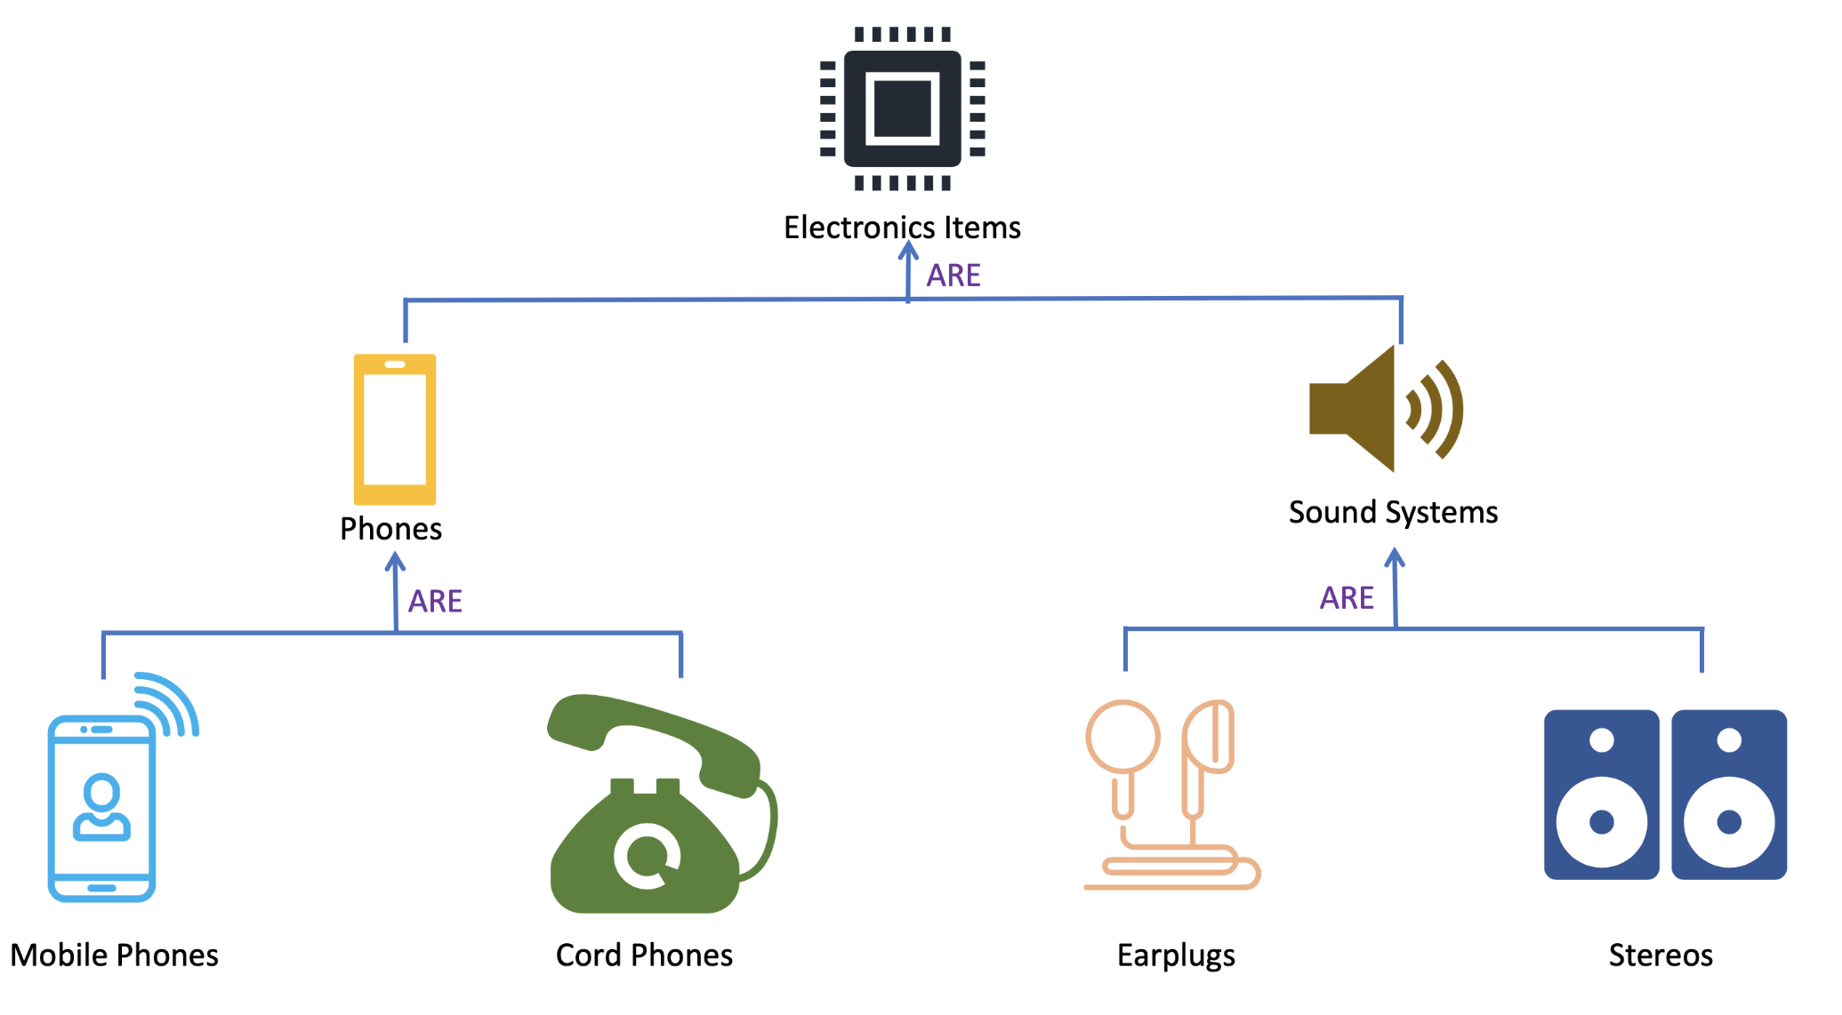

Slide 8
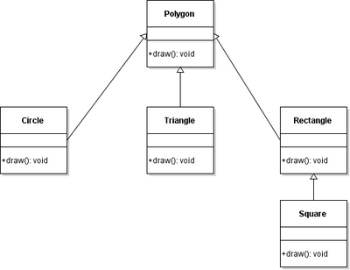

Slide 9
Objects :
My name is Akhil, and I am an instance/object of class Man
Abstraction :
Abstraction means, showcasing only the required things to the outside world while hiding the details
Continuing our example, HumanBeing’s can talk, walk, hear, eat, but the details of the muscles mechanism and their connections to the brain are hidden from the outside world

Slide 10
Encapsulation :
Encapsulation means that we want to hide unnecessary details from the user
For example, when we call from our mobile phone, we select the number and press call button
But the entire process of calling or what happens from the moment we press or touch the call button to the moment we start having a phone conversation is hidden from us

Slide 11
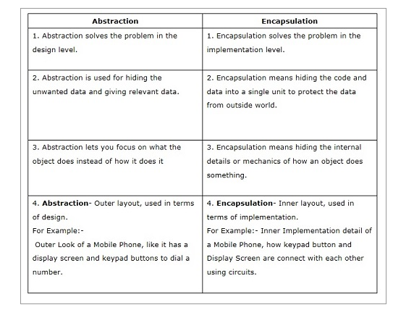

Slide 12
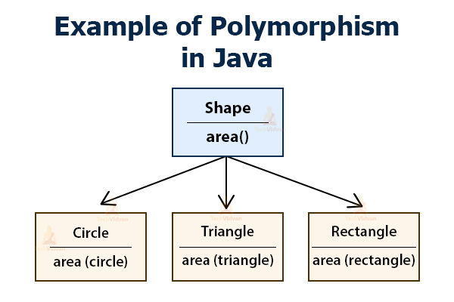
Polymorphism :
Polymorphism is a feature of object-oriented programming languages that allows a specific routine to use variables of different types at different times

Slide 13
Cohesion and Coupling
Cohesion and Coupling:Two OO Design Principles
Cohesion refers to the degree to which elements within a module/object work together to fulfill a single, well-defined purpose. High cohesion means that elements are closely related and focused on a single purpose, while low cohesion means that elements are loosely related and serve multiple purposes.
Coupling refers to the degree of interdependence between software modules. High coupling means that modules are closely connected and changes in one module may affect other modules. Low coupling means that modules are independent, and changes in one module have little impact on other modules.

Slide 14
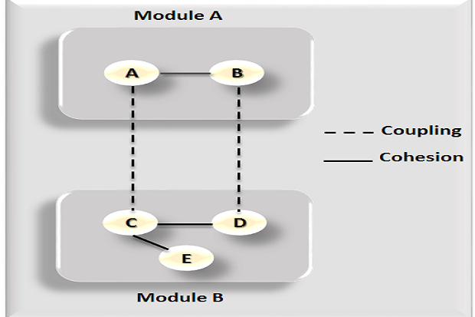
Cohesion and Coupling

Slide 15
Cohesion and Coupling
Advantages of high cohesion
Reduced module complexity (they are simpler, having fewer operations).
Increased system maintainability, as logical domain changes touch fewer modules and changes in one module necessitate fewer changes in others.
Increased module reusability, as application developers will be able to discover the component they require more readily among the module's cohesive collection of activities.

Slide 16
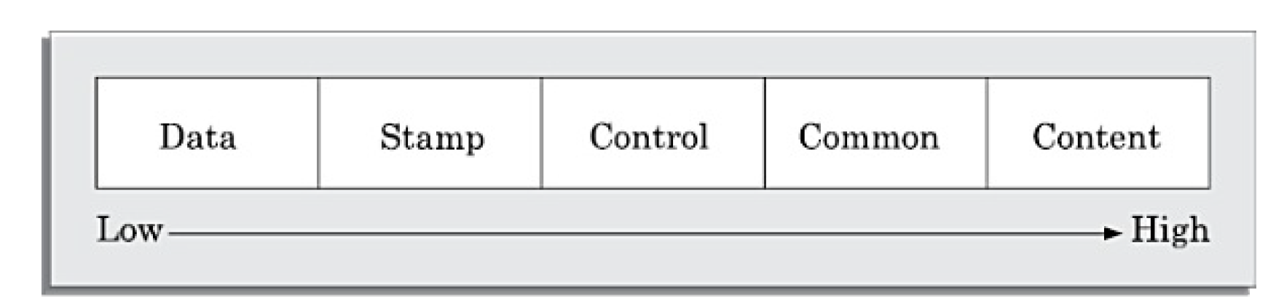
Coupling
Data coupling: Two modules are data coupled, if they communicate using
an elementary data item that is passed as a parameter between the two, e.g.
an integer, a float, a character, etc. This data item should be problem related
and not used for control purposes.
Stamp coupling: Two modules are stamp coupled, if they communicate
using a composite data item such as a record in PASCAL or a structure in C.

Slide 17
Cohesion
Control coupling: Control coupling exists between two modules, if data
from one module is used to direct the order of instruction execution in
another. An example of control coupling is a flag set in one module and
tested in another module.
Common coupling: Two modules are common coupled, if they share some
global data items.
Content coupling: Content coupling exists between two modules, if they
share code. That is, a jump from one module into the code of another module
can occur. Modern high-level programming languages such as C do not
support such jumps across modules.
The degree of coupling increases from data coupling to content coupling. High coupling among modules not only makes a design solution difficult to
understand and maintain, but it also increases development effort and also
makes it very difficult to get these modules developed independently by
different team members.

Slide 18
The concept of "loose coupling and high cohesiveness" underpins many of the design ideas and patterns that have been developed.

